Slide 1
COMPILER CONSTRUCTION CS F363
Preliminaries
Role of Symbol Table
Implementation
COMPILER CONSTRUCTION CS F363
Syntax Directed Translation
R. Elakkiya, AP/CS

Slide 2
Text Book Chapter 5
Section 5.1,5.2

Slide 3
Syntax-Directed Translation
Translation of languages guided by CFG
Use of Translation
Type checking
Intermediate-code generation
How is translation done?
Associate semantic rules with productions
Translation schemes:
Syntax-Directed Definitions
Syntax-Directed Translation

Slide 4
Syntax-Directed Definition
A Syntax Directed Definition (SDD) is a context free grammar where
Semantic rules are associated with productions
Attributes are associated with grammar symbols
If ‘X’ is a symbol and ‘a’ is one of its attribute then X.a denotes value of ‘a’ at ‘X’
An attribute may hold almost any thing.
a string, a number, a memory location, a record
Grammar Semantic rule
E → E+T E.val = E.val +T.val
E → T E.val =T.val

Slide 5
Types of Attributes in SDD
Synthesized Attributes: If a node takes values from its children node and itself then it is synthesized attribute
Ex: A→BCD (A is parent, B,C, & D are children)
A.S = B.S
A.S = C.S
A.S = D.S
Inherited Attributes: If a node takes values from its parent, sibiling node and itself then it is inherited attribute
Ex: A→BCD (A is parent, B,C, & D are children)
C.i =A.i (Parent node)
C.i =B.i(Sibiling)
C.i = D.i(sibiling)

Slide 6
Attributes of Terminals
Terminals can have synthesized attributes, but not inherited attributes
Attributes for terminals have lexical values that are supplied by the lexical analyser
There are no semantic rules in the SDD itself for computing the value of an attribute for a terminal

Slide 7
Syntax-Directed Definition for expression grammar
Production Semantic Rules
L → E return print(E.val)
E → E₁ + T E.val = E₁.val + T.val
E → T E.val = T.val
T → T₁ * F T.val = T₁.val * F.val
T → F T.val = F.val
F → ( E ) F.val = E.val
F → digit F.val = digit.lexval
Symbols E, T, and F are associated with an attribute val.
The token digit has a synthesized attribute lexval (it is an integer value returned by the lexical analyzer).

Slide 8
Types of SDD
Two sub-classes of the syntax-directed definitions:
S-Attributed SDD: only synthesized attributes are used in the syntax-directed definitions
L-Attributed SDD: in addition to synthesized attributes, it also uses inherited attributes in a restricted fashion
An S-attributed SDD can be implemented naturally in conjunction with an LR parser
Semantic rules in SDD may involve side effects like printing
An SDD without side effects (they can only evaluate values of attributes) is sometimes called an attribute grammar
Implementations of S-attributed Definitions are a little bit easier than implementations of L-Attributed Definitions

Slide 9
Types of SDD - Examples
S-Attributed SDD | S-Attributed Definitions | S-Attributed Grammar
A SDD that uses only S-attributes is called S-Attributed SDD
Ex: A→BCD (A is parent, B,C, & D are children)
A.S = B.S
A.S = C.S
A.S = D.S
L-Attributed SDD | L-Attributed Definitions | L-Attributed Grammar
A SDD that uses Synthesized and Inherited attributes but inherit only from parent or Left sibling
Ex: A→BCD {C.S = A.S, C.S=B.S, not C.S = D.S}

Slide 10
Evaluating an SDD
Evaluation of a semantic rule defines the value of an attribute
How to visualize the translation specified by an SDD?
Apply the rules of an SDD and construct a parse tree
Use the rules to evaluate all of the attributes at each of the nodes of the parse tree
Before we can evaluate an attribute at a node of a parse tree, we must evaluate all the attributes upon which its value depends
With only synthesized attributes, we can evaluate attributes in any bottom-up order, such as that of a postorder/DFS traversal of the parse tree
For SDD's with both inherited and synthesized attributes, there is no guarantee that there is even one order in which to evaluate attributes at nodes

Slide 11
Evaluating an SDD
For instance, consider nonterminals A and B, with synthesized and inherited attributes A.s and B.i, respectively, along with the production and rules
PRODUCTION SEMANTIC RULES
A → B A.s = B.i;
B.i = A.s + 1
These rules are circular; it is impossible to evaluate either A.s at a node N or B.i at the child of N without first evaluating the other

Slide 12
Annotated Parse Tree
A parse tree showing the values of attributes at each node is called an annotated parse tree.
The process of computing the attributes values at the nodes is called annotating (or decorating) of the parse tree.

Slide 13
S-Attributed SDD Example
Production Semantic Rules
L → En print(E.val)
E → E₁ + T E.val = E₁.val + T.val
E → T E.val = T.val
T → T₁ * F T.val = T₁.val * F.val
T → F T.val = F.val
F → ( E ) F.val = E.val
F → digit F.val = digit.lexval
Symbols E, T, and F are associated with a synthesized attribute val.
The token digit has a synthesized attribute lexval (it is assumed that it is evaluated by the lexical analyzer).

Slide 14
Example Attribute Grammar in Yacc
%token DIGIT
%%
L : E ‘\n’ { printf(“%d\n”, $1); }
;
E : E ‘+’ T { $$ = $1 + $3; }
| T { $$ = $1; }
;
T : T ‘*’ F { $$ = $1 * $3; }
| F { $$ = $1; }
;
F : ‘(’ E ‘)’ { $$ = $2; }
| DIGIT { $$ = $1; }
;
%%

Slide 15
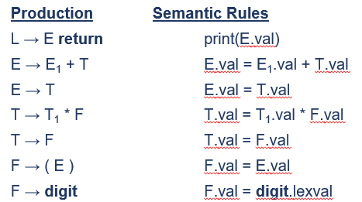
Annotated Parse Tree: S-Attributed SDD Example 1
Input: 5+3*4
L
E.val=17 return
E.val=5 + T.val=12
T.val=5 T.val=3 * F.val=4
F.val=5 F.val=3 digit.lexval=4
digit.lexval=5 digit.lexval=3

Slide 16
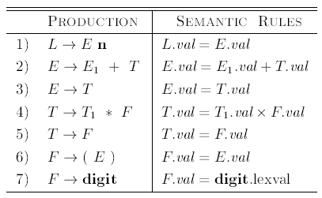
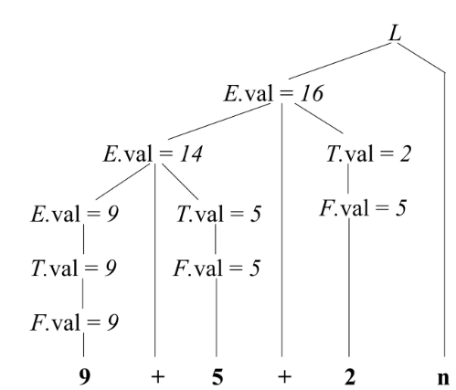
Annotated Parse Tree: S-Attributed SDD Example 2
Input: 9 + 5 + 2 n

Slide 17
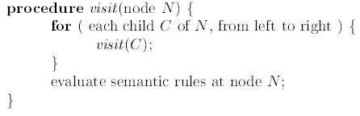
DFS Traversal of Annotated Parse Tree for attribute evaluation
Input: 9+5+2 n
A DF Left to Right traversal of a tree

Slide 18
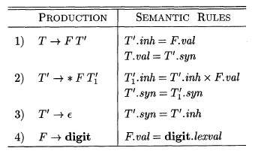
Annotated Parse Tree: L- Attibuted SDD Example 3
Input: 3*5

Slide 19
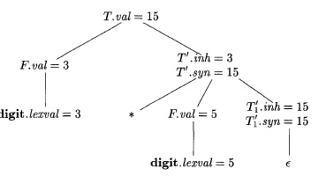
Annotated Parse Tree: L- Attibuted SDD Example 3
Input: 3*5

Slide 20
Evaluation Orders for SDD's
Semantic rules set up dependencies between attributes
This dependency can be represented by a dependency graph
The dependency graph determines the evaluation order of the semantic rules

Slide 21
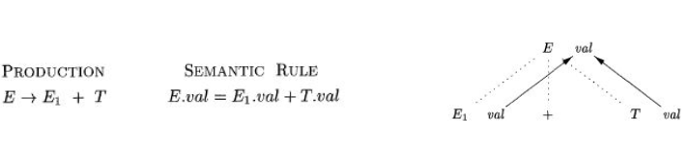
Dependency Graphs
A dependency graph depicts the flow of information among the attribute instances in a particular parse tree
An edge from one attribute instance to another means that the value of the first is needed to compute the second
Use: It provides possible evaluation orders in which we can evaluate the attributes at the various nodes of a parse tree
Evaluation Order: Sequences of nodes N1, N2, ..., Nk such that if there is an edge of the dependency graph from Ni to Nj, then i < j

Slide 22
Dependency Graphs
Topological sort of the graph: An ordering that embeds a directed graph into a linear order
If there is any cycle in the graph
There are no topological sorts
That is, there is no way to evaluate the SDD on this parse tree.
If there are no cycles
There is always at least one topological sort

Slide 23
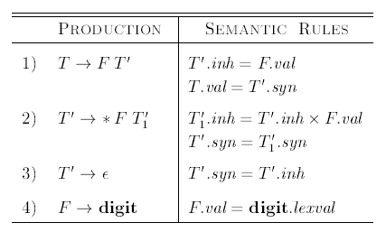
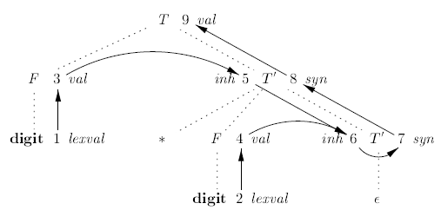
Dependency Graph Example 1
Input: 3*5
Evaluation order: 1, 2, 3, 4, 5, 6, 7, 8, 9

Slide 24
Dependency Graph Example 2
Input: 5+3*4
L
E.val=17
11
E.val=5 T.val=12
10
4
3
T.val=5 T.val=3 F.val=4
9
7
F.val=5 F.val=3 digit.lexval=4
2
6
8
digit.lexval=5 digit.lexval=3
1
5
Evaluation order: 1, 2, 3, 4, 5, 6, 7, 8, 9, 10, 11

Slide 25
Tutorial 1
Production Semantic Rules
D → T L L.in = T.type
T → int T.type = integer
T → real T.type = real
L → L₁ ,id L₁.in = L.in, addtype(id.entry,L.in)
L → id addtype(id.entry,L.in)
Draw the annotate parse tree for the declaration real id1, id2, id3
Draw the dependency graph and find an evaluation order.
Inherited
Synthesized

Slide 26
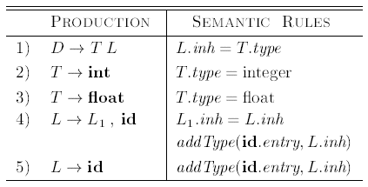
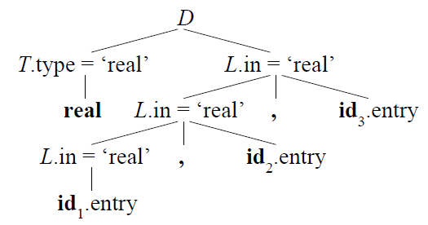
Annotated Parse Tree real id1, id2, id3
addType properly installs the type L.inh as the type of the represented identifier

Slide 27
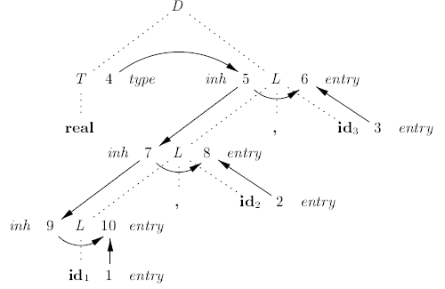
Dependency graph real id1, id2, id3
1. Get id1.entry
2. Get id2.entry
3. Get id3.entry
4. T1.type=‘real’
5. L1.in=T1.type
6. addtype(id3.entry, L1.in)
7. L2.in=L1.in
8. addtype(id2.entry, L2.in)
9. L3.in=L2.in
10. addtype(id1.entry, L3.in)

Slide 28
Tutorial 2
Draw the annotated parse tree for the input: 3 * 5 + 4 n
Use the SDD shown

Slide 29
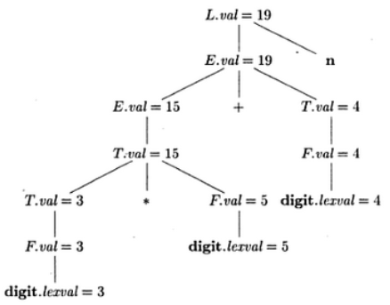
Tutorial 2
Input: 3 * 5 + 4 n

Slide 30
Syntax Directed Translation
Combination of CFG & Semantic actions
The semantic actions (denoted in {}) can be placed anywhere on the RHS
Evaluation order: Traversing from top to bottom (left to right) in the parse tree
Conversion of infix to postfix
E→E+T{print(‘+’);}
E → T
T → T*F {print(‘*’);}
T → F
F → num {print num.val;}

Slide 31
Syntax Directed Translation – Example 1
Conversion of infix to postfix
E→E+T{print(‘+’);}
E → T
T → T*F {print(‘*’);}
T → F
F → num {print num.val;}
Input: 2+3*4
2 3 4 * +
E
{print(‘+’);}
E + T
{print(‘*’);}
T T * F
F F num{print num.val;}
4
num{print num.val;} num{print num.val;}
2 3

Slide 32
Syntax Directed Translation – Example 2
E→E+T{print(‘+’);}|T
T → num {print num.val;}
Input:1+2
E
T E`
E→TE`
E`→ +T{print(‘+’);}E`
E`→epsilon
T → num {print num.val;}
num{print num.val;} + T {print(+);}
1
num{print num.val;}
2
1 2+

Slide 33
Syntax-Directed Translation schemes
Syntax-Directed Definitions:
give high-level specifications for translations
hide implementation details such as order of evaluation of semantic actions
We associate a production rule with a set of semantic actions, and we do not say when they will be evaluated
more readable, and hence more useful for specifications
Translation Schemes:
indicate the order of evaluation of semantic actions associated with a production rule.
In other words, translation schemes give a little bit information about implementation details.

Slide 34
Thank You!

